Slide 1
Python session Loops and Operators - Dhilip Kumar (software Engineer at Intelizign)

Slide 2
Table of Content
Data types – Recap
All about Loops
Introduction
Animated Video on Loops
For Loop
While Loop
Operation on Loops
Nested Loops
Case statement
Use case about loops
3. Operators in python
Arithmetic operator
Assignment operator
Comparision operator
Logical operator
Identity operator
Membership operator
Bitwise operator

Slide 3

Data Types - Recap
List - List items are ordered, changeable, and allow duplicate values.
Example : To do List Chart
Tuple – Tuple are nonchangeable and allow duplicate value.
Example: Geometry Co-ordinates
String – String are nonchangeable and it is text format.
Example: Output text from application to communicate to user.
Dictionary – Dictionary are key value pair (Hash map – storing the objects)
Example: Acting as a Database/dataset
Sets – Sets are changeable and unordered and will allow duplicate values.
Example: Collecting all unique suggestions or feedback from participants.

Slide 4

2. All about Loops
Introduction
1. Automate repetitive tasks.
2. Simplify code and reduce errors.
3. Efficient Data Processing.
4. Simplify Complex Operations.
5. Enhancing Code Readability and Maintenance.
6. Automating Workflows.

Slide 5

2. All about Loops
Animated Video on Loops

Slide 6
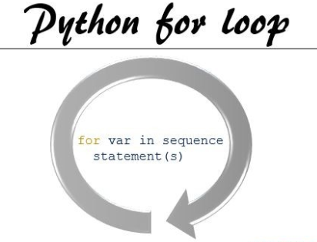
2. All about Loops
For Loops

Slide 7

2. All about Loops
While Loops

Slide 8
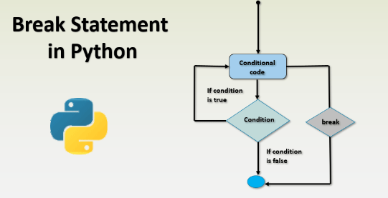
2. All about Loops
Break Statement

Slide 9
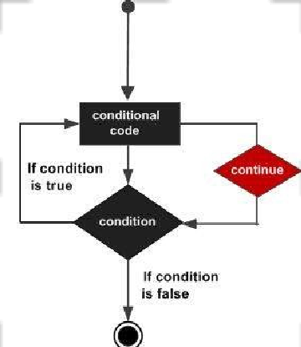
2. All about Loops
Continue statement

Slide 10
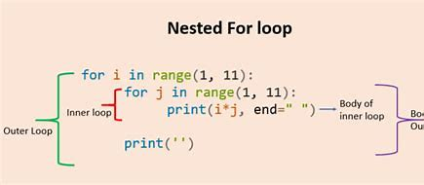
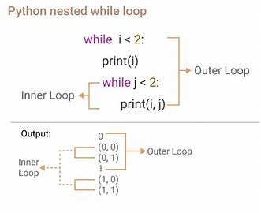

2. All about Loops
Nested Loops

Slide 11
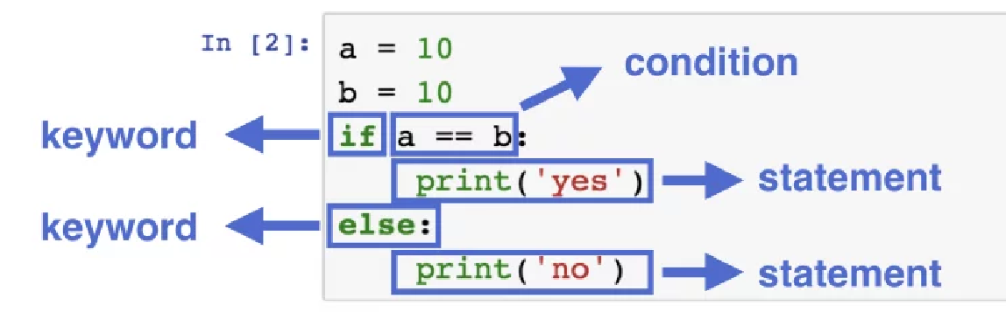

2. All about Loops
Case statement
If – Else Statement

Slide 12
2. All about Loops
Use case – Fruit Market using For Loops
I am at the fruit market I love to buy some mango until my bag get occupied.
I have some condition - I need to pick raw mango instead of ripe one because I will eat after two days.

Slide 13
2. All about Loops
Use Case: ATM Withdrawal System
Imagine an ATM withdrawal system where a myself can attempt to withdraw money multiple times. Constrain:
I can attempt withdrawal up to three times.
System will skip the attempt if the withdrawal amount is zero or negative.
System will stop withdrawal if amount exceeds the account balance.

Slide 14
Question and Answer

Slide 15
Thank you

